Slide 1

.Net Blazor Framework Overview
By Abhilash

Slide 2
What is Blazor?
Blazor is a .Net SPA framework maintained by Microsoft using c# and html that runs in browser via WEBASSEMBLY
Browser + Razor = Blazor
Uses component based architecture
Javascript is not going away, but it’s a new choice

Slide 3
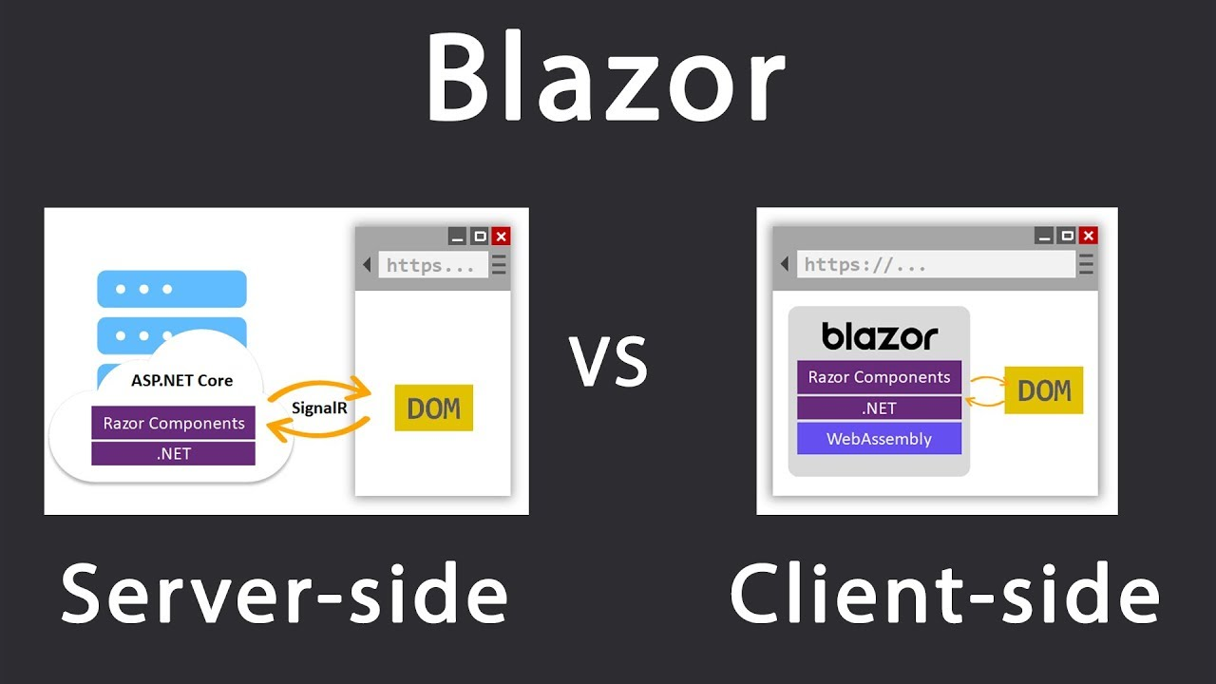
Blazor Web Models

Slide 4
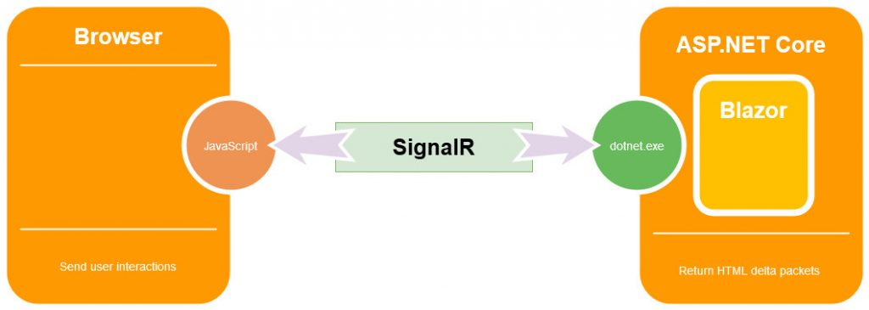
Blazor Server Side
It was released back in September 2019
Uses signalR web socket connection
It runs on the server on top of the full .Net core runtime

Slide 5


Web Assembly (https://webassembly.org/)
W3C consortium approved
WebAssembly (abbreviated Wasm) is a binary instruction format.
Wasm is designed as a portable compilation target for programming languages, enabling deployment on the web for client and server applications
Efficient and fast
Safe, Open and debuggable, Part of the open web platform

Slide 6
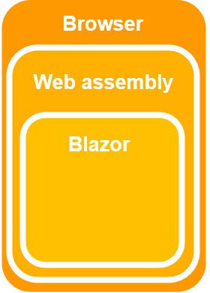
Blazor Client Side
It was released on May 2020
By using WebAssembly, we are able to write our UI logic using C# and not with any client side scripting language

Slide 7
Server App Vs Client App
Server App
Pros | Cons
Runs on the full .NET Core runtime | Doesn’t work well in high latency environments
Fast development | No offline support
Small download size | Heavy resource
Code is kept on the server
Client App
Pros | Cons
Compiles to static files | Payload.
Work is offloaded | Load time
Apps can be run in an offline state | Restricted runtime

Slide 8
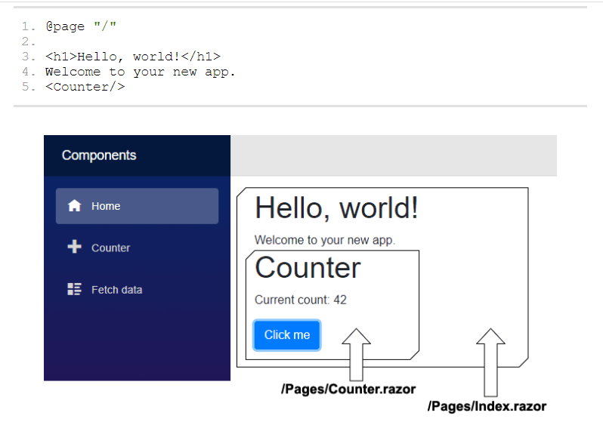
Components
All blazor views descend from ComponentBase class
Blazor page is essentially a component with a @page directive that specifies URL
Index.razor.g.cs in the folder obj\Debug\netcoreapp3.0\Razor\Pages.

Slide 9
Directives
@code - This directive identifies a block of C# code that should be output as-is into the resulting C# file
@page - This directive generates a PageAttribute on the transpiled class
@inject - Allows components to specify dependencies they require to be injected by Blazor
@bind, @onmousemove, @onclick, @onkeypress, @onscroll

Slide 10

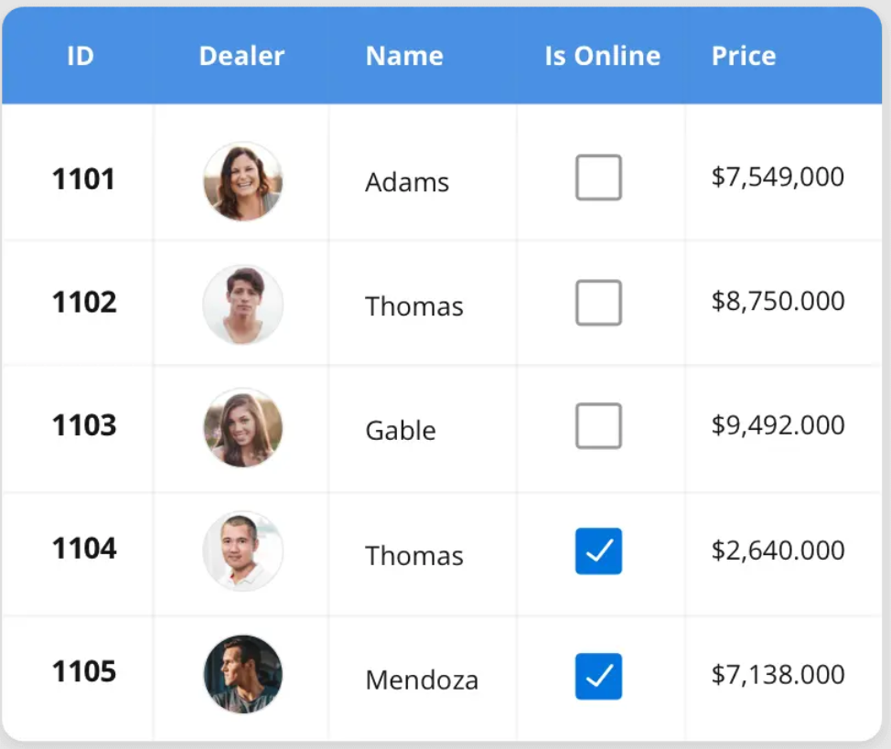
SyncFusion – Support to blazor
Fast and powerful Grid
Adaptive UI
Touch Support
Globalization and Localization
Sorting, Paging, Filtering
All CRUD operations
Aggregated Column Values
Export to Excel, PDF and CSV

Slide 11
SyncFusion – Support to blazor
Why we need to use SyncFusion ?
70+ components
Work with Client & Server
Fine tuned to work with huge volume of data
Good documentation
Unlimited support
https://www.syncfusion.com/blazor-components

Slide 12
Demo

Slide 13
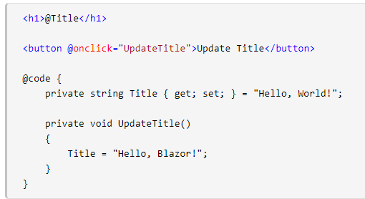
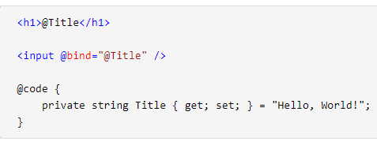
Binding
One way binding
One Way Binding Between Components
Two way binding
Two Way Binding Between Components
Two Way Binding To A Specific Event

Slide 14
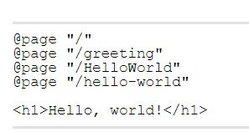
Routing
It’s specified along with @page directive
App.razor has router component
It will add RouteAttribute

Slide 15
Conclusion
Go for client app -> For SPA approach and api services
For intranet application and quick dev -> Go for Server app
Share validation logic and models b/w UI and backend
Its not replacing JavaScript or other SPAs but its another option
C# developers can build modern full stack application

Slide 16
References
https://blazor.net/
https://github.com/AdrienTorris/awesome-blazor
https://blazor-university.com/
https://www.youtube.com/watch?v=KOMo77bVKSw
https://www.youtube.com/watch?v=8De8DlrCzoY

Slide 17


Slide 18
THANK YOU

